Slide 1


Recent Results in GW Astrophysics and Cosmology
Will M. Farr
YITP
3 October 2019
@farrwill
farr
This talk: http://bit.ly/2n5urdH

Slide 2

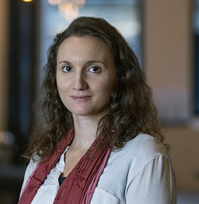


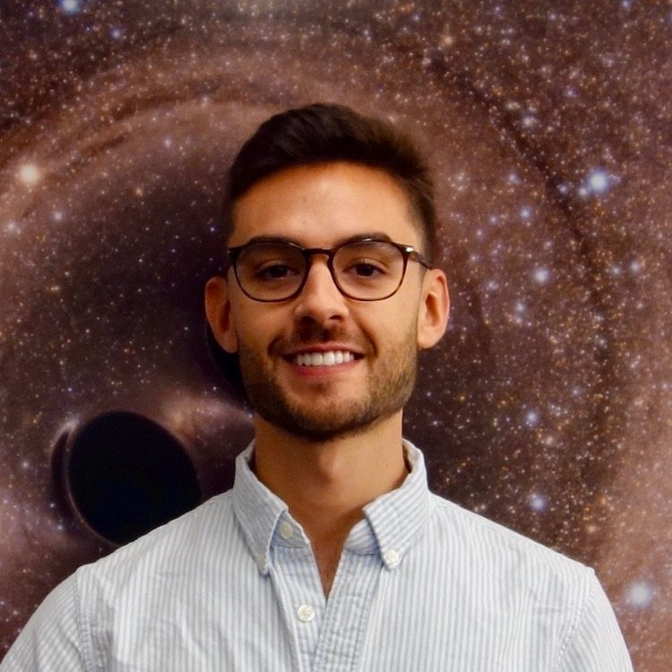
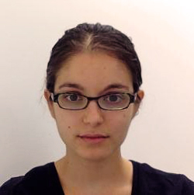
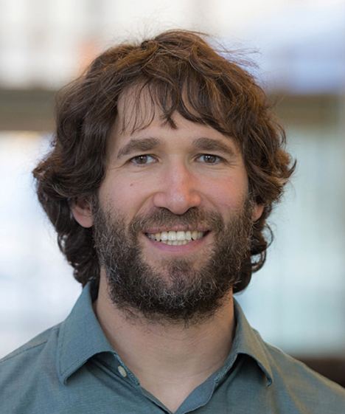
Dramatis Personae
Chiara
Mingarelli
Katerina
Chatziioannou
Tom
Callister
Masha (Maria)
Okounkova
Jiani Ye
Maya Fishbach
Max Isi
Daniel Holz

Slide 3
Farr, Fishbach, Ye & Holz, ApJL, 883, L42 (2019)
Chiara
Mingarelli
Katerina
Chatziioannou
Tom
Callister
Masha (Maria)
Okounkova
Jiani Ye
Max Isi
Maya Fishbach
Daniel Holz

Slide 4
Isi, Giesler, Farr, Scheel, Teukolsky, PRL, 123, 111102 (2019)
Chiara
Mingarelli
Katerina
Chatziioannou
Tom
Callister
Masha (Maria)
Okounkova
Jiani Ye
Maya Fishbach
Max Isi
Daniel Holz

Slide 5
Isi, Chatziioannou & Farr, PRL, 123, 121101 (2019)
Chiara
Mingarelli
Katerina
Chatziioannou
Tom
Callister
Masha (Maria)
Okounkova
Jiani Ye
Maya Fishbach
Max Isi
Daniel Holz

Slide 6
Okounkova & Farr, in prep
Chiara
Mingarelli
Katerina
Chatziioannou
Tom
Callister
Masha (Maria)
Okounkova
Jiani Ye
Maya Fishbach
Max Isi
Daniel Holz

Slide 7
LIGO Orientation

Slide 8
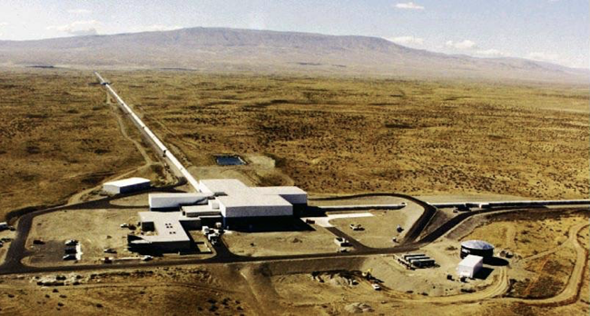
LIGO
LIGO

Slide 9
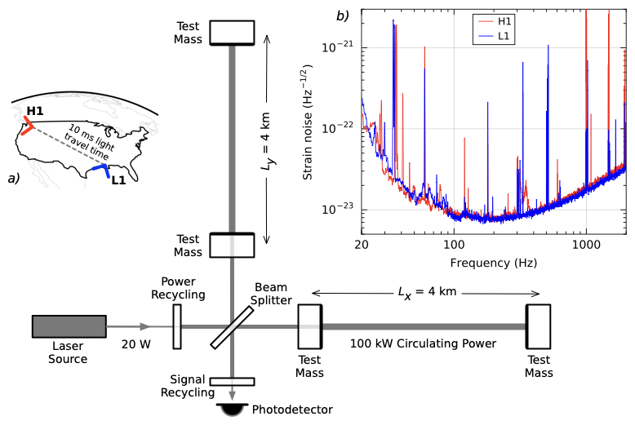
LIGO
Abbott, et al. (2016)

Slide 10
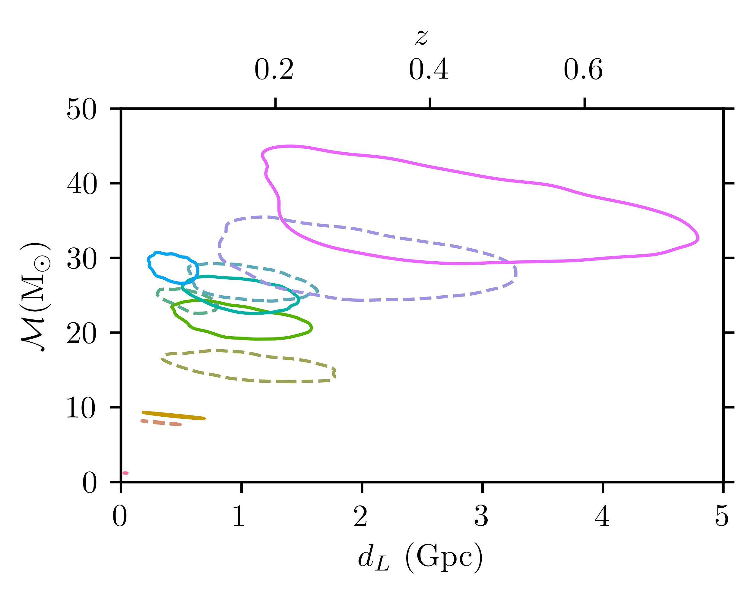
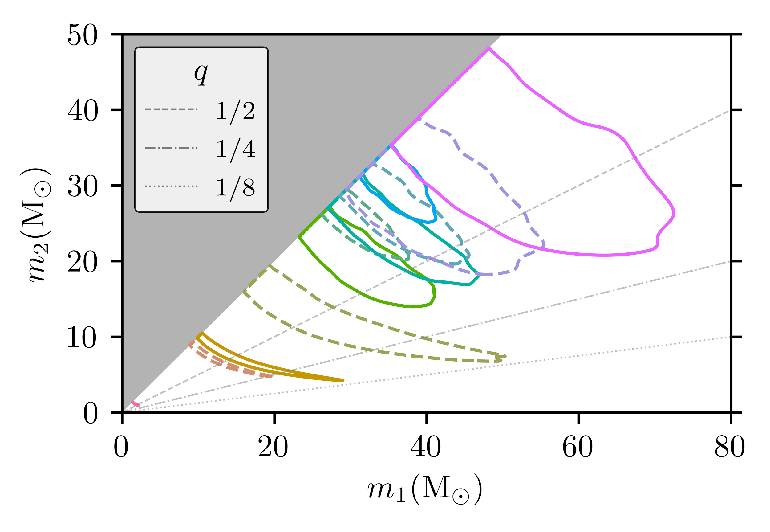
GWTC-1
Abbott, et al. (2019)

Slide 11
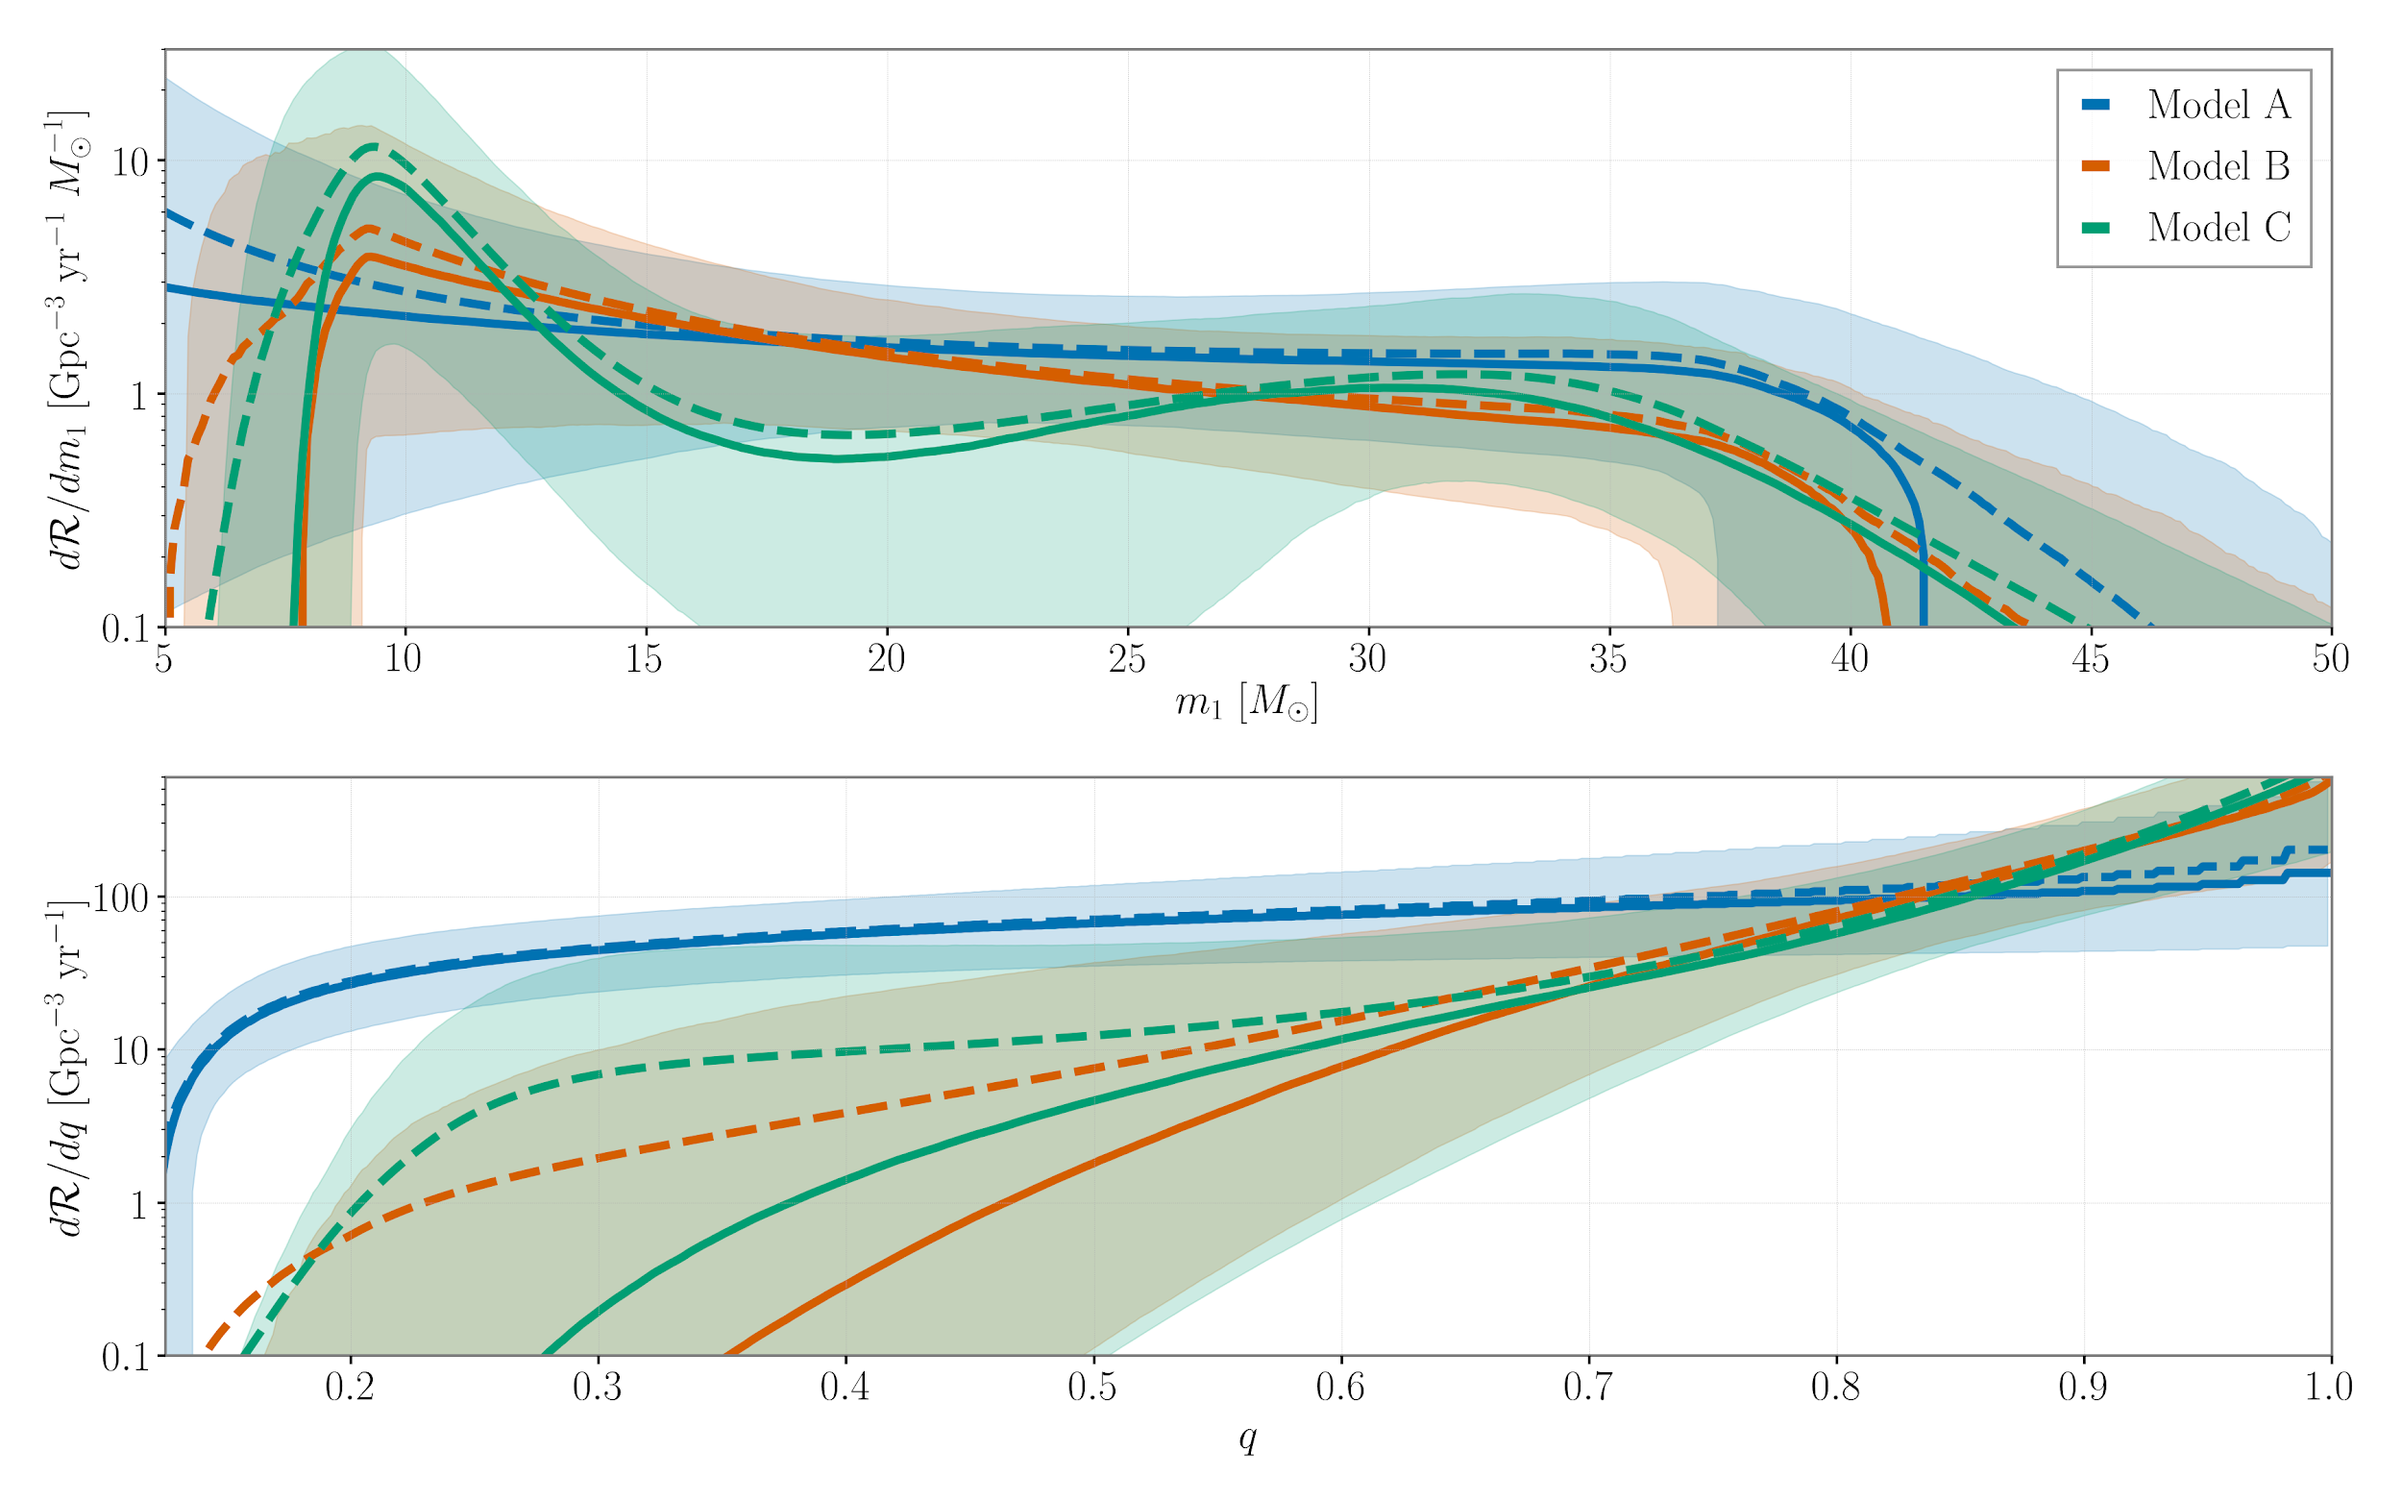
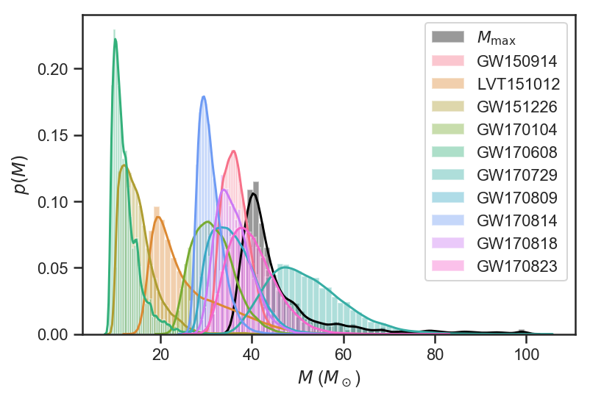
LIGO Populations
Abbott, et al. (2019)

Slide 12
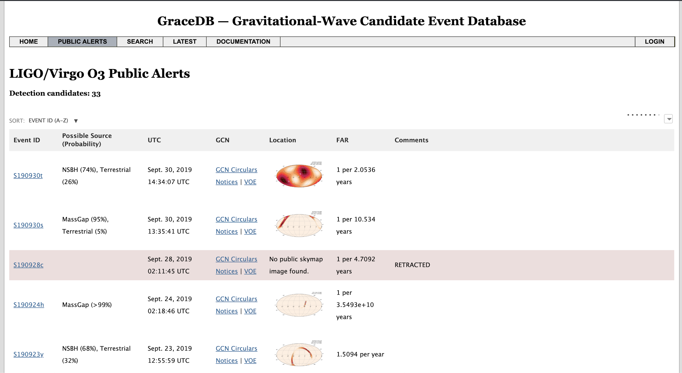
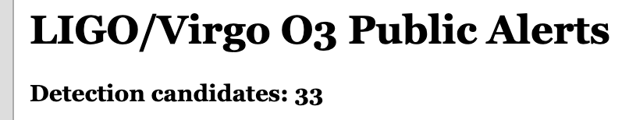
O3 is Off the Hook: Public Event Notices

Slide 13
O3 is Off the Hook: Public Event Notices
Catalog paper expected ~April 2020!

Slide 14
Farr, Fishbach, Ye & Holz, ApJL, 883, L42 (2019)
Chiara
Mingarelli
Katerina
Chatziioannou
Tom
Callister
Masha (Maria)
Okounkova
Jiani Ye
Max Isi
Maya Fishbach
Daniel Holz

Slide 15
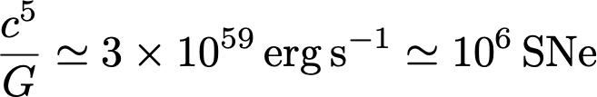
GW Distances are Easy

Slide 16
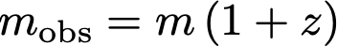
GW Redshifts Are Hard

Slide 17
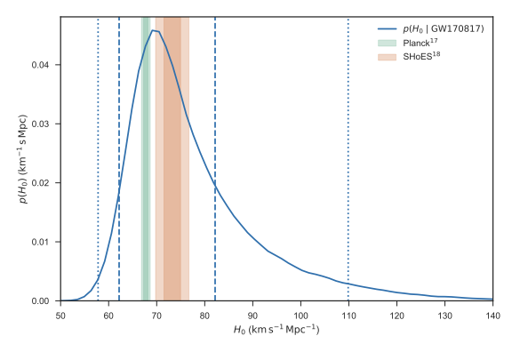
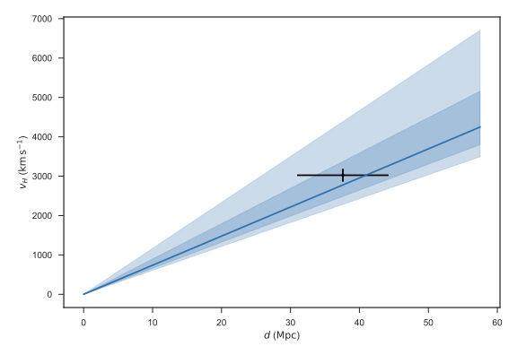
Easy Mode: GW + EM Measurements
Abbott, et al. (2017)

Slide 18
Redshifts Without EM Observations

Slide 19
Redshifts Without EM Observations
If I know this

Slide 20
Redshifts Without EM Observations
If I know this
Then I can measure this.
Chernoff & Finn (1993)
Taylor & Gair (2012)

Slide 21
BBH >> BNS

Slide 22
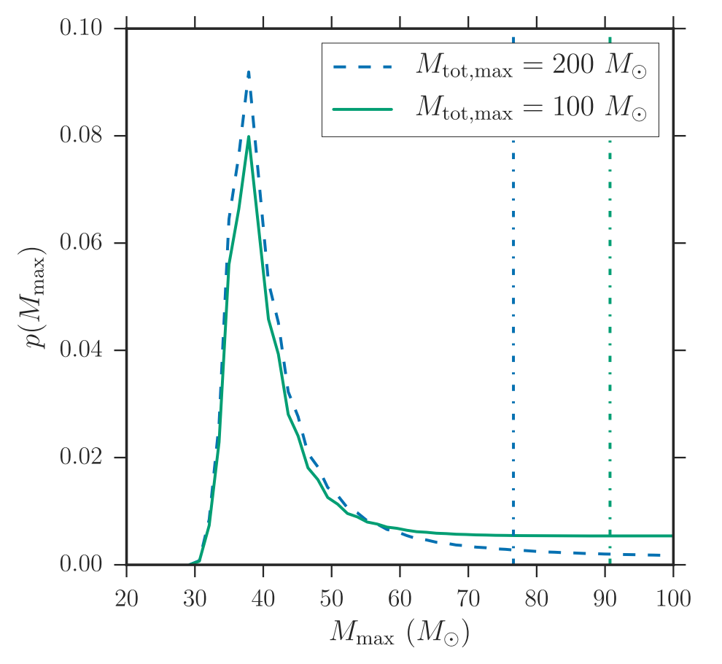
Where are LIGO’s Big Black Holes?
Fishbach & Holz (2017)

Slide 23
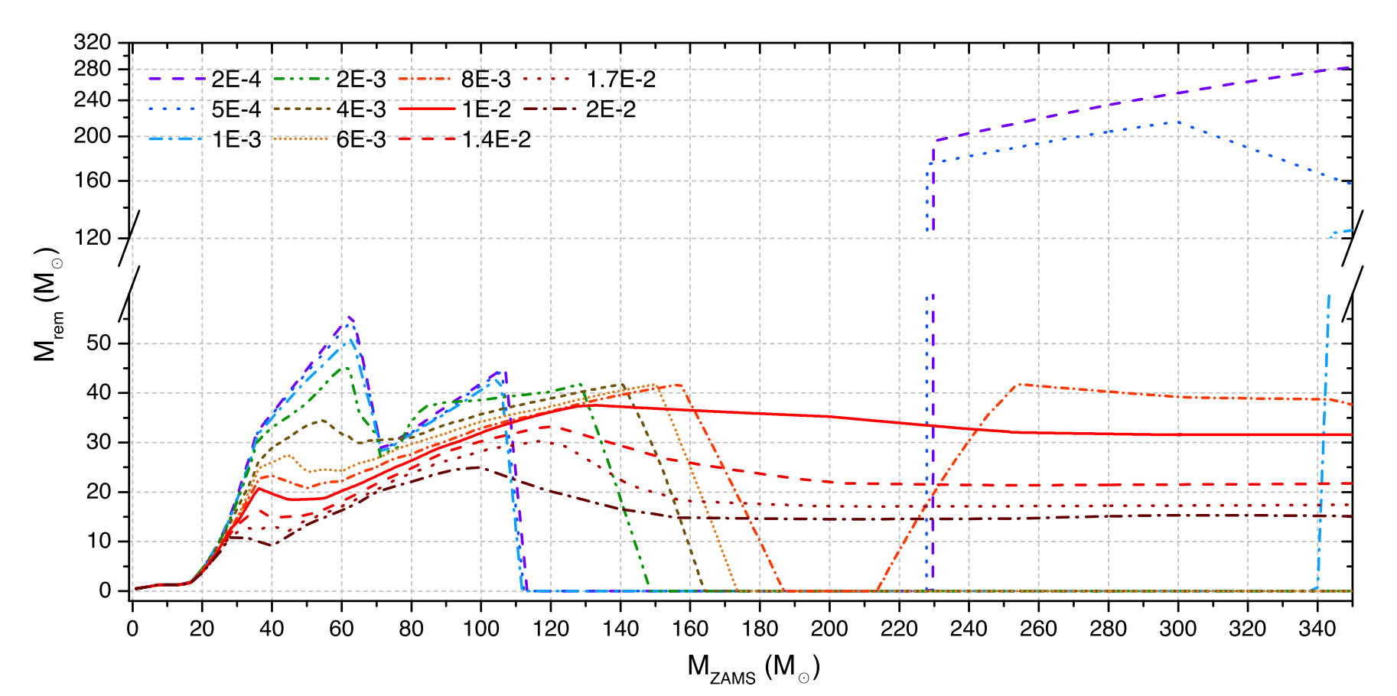
Pair Instability Supernovae
Spera & Mapelli (2017)

Slide 24
LIGO Populations (PISN Bump?)
Abbott, et al. (2019)

Slide 25
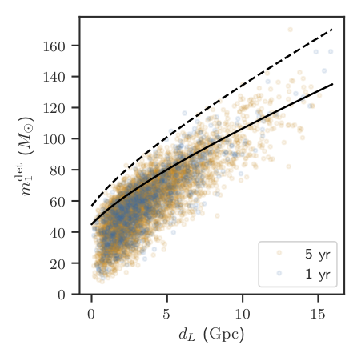
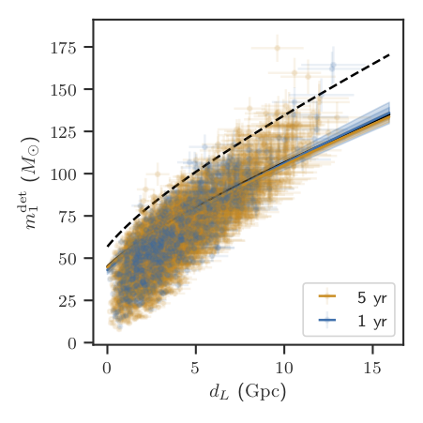
What It Might Look Like in 2020s

Slide 26
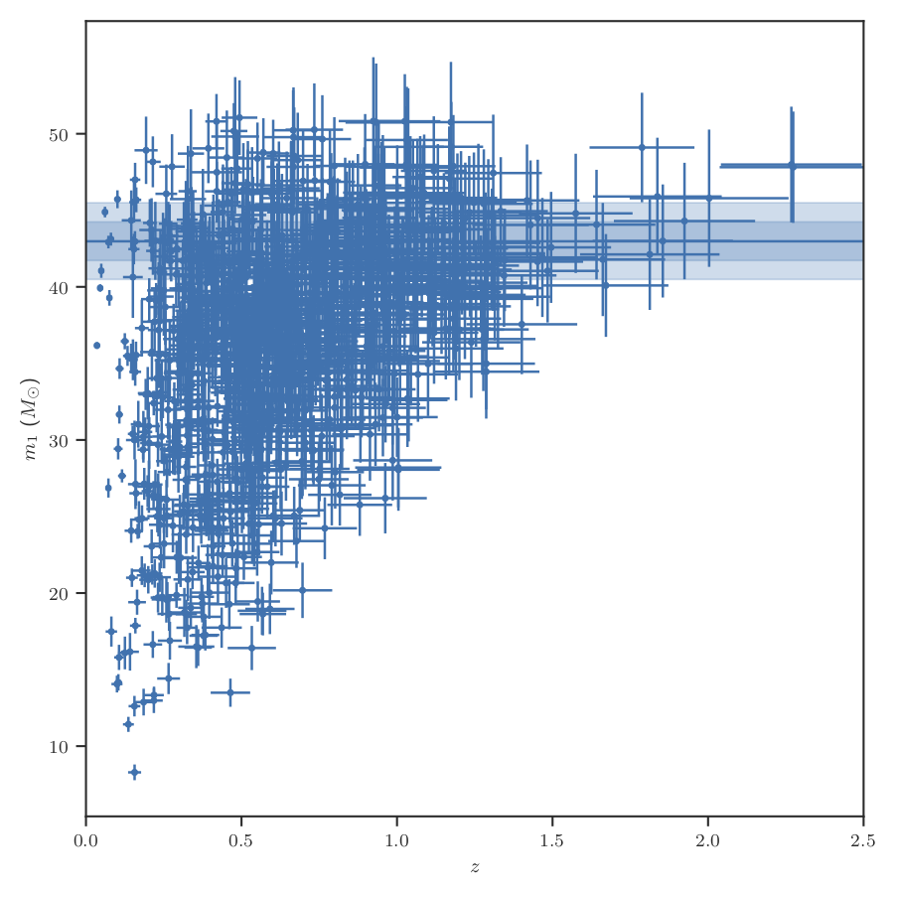
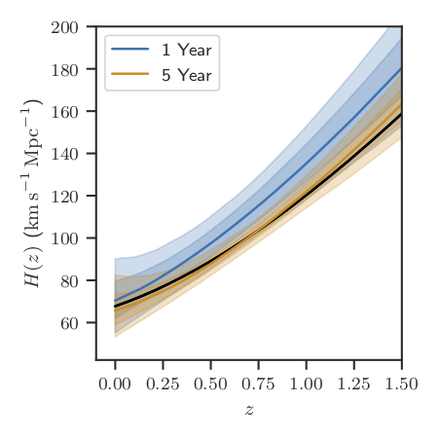
H(z) Measurement

Slide 27
H(z) Measurement
3% at z ~ 0.8 (H0: +/- 2 km/s/Mpc)!

Slide 29
Isi, Giesler, Farr, Scheel, Teukolsky, PRL, 123, 111102 (2019)
Chiara
Mingarelli
Katerina
Chatziioannou
Tom
Callister
Masha (Maria)
Okounkova
Jiani Ye
Maya Fishbach
Max Isi
Daniel Holz

Slide 30
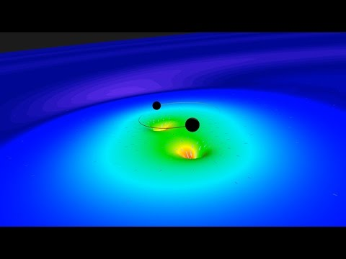
Black Holes Have Spectra (GW150914)

Slide 31
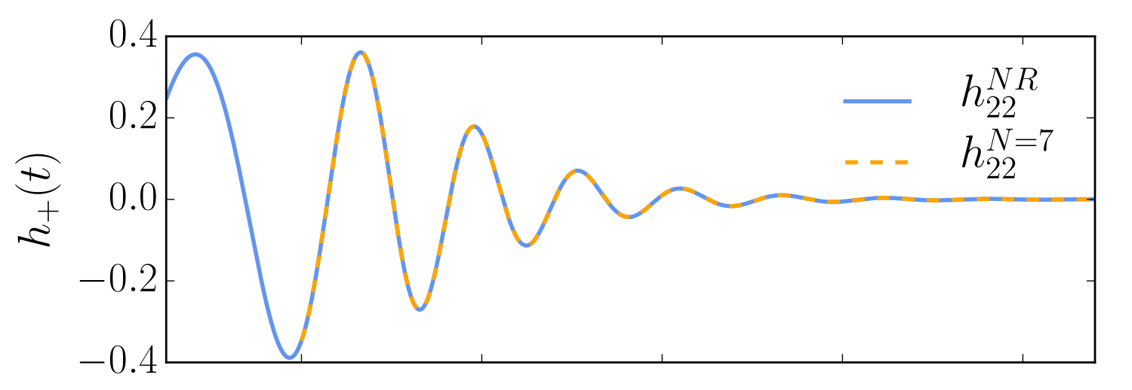
Kerr Normal Modes (GW150914-Like)
Giesler, et al. (2019)

Slide 32
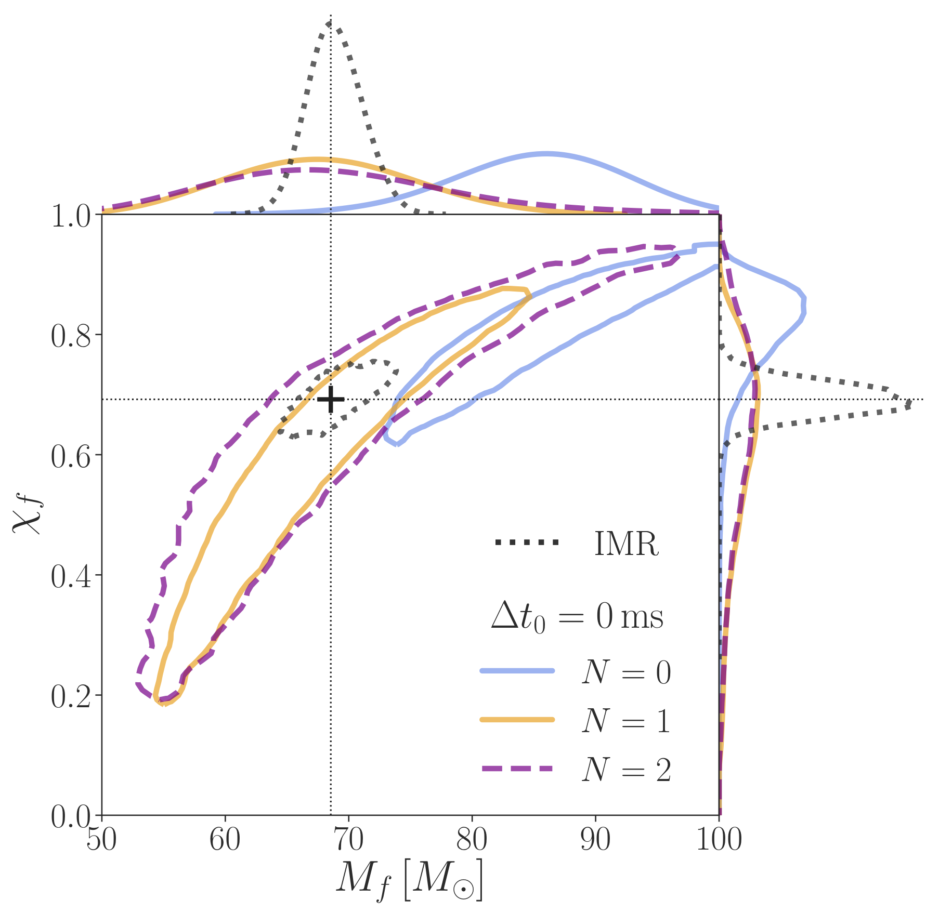
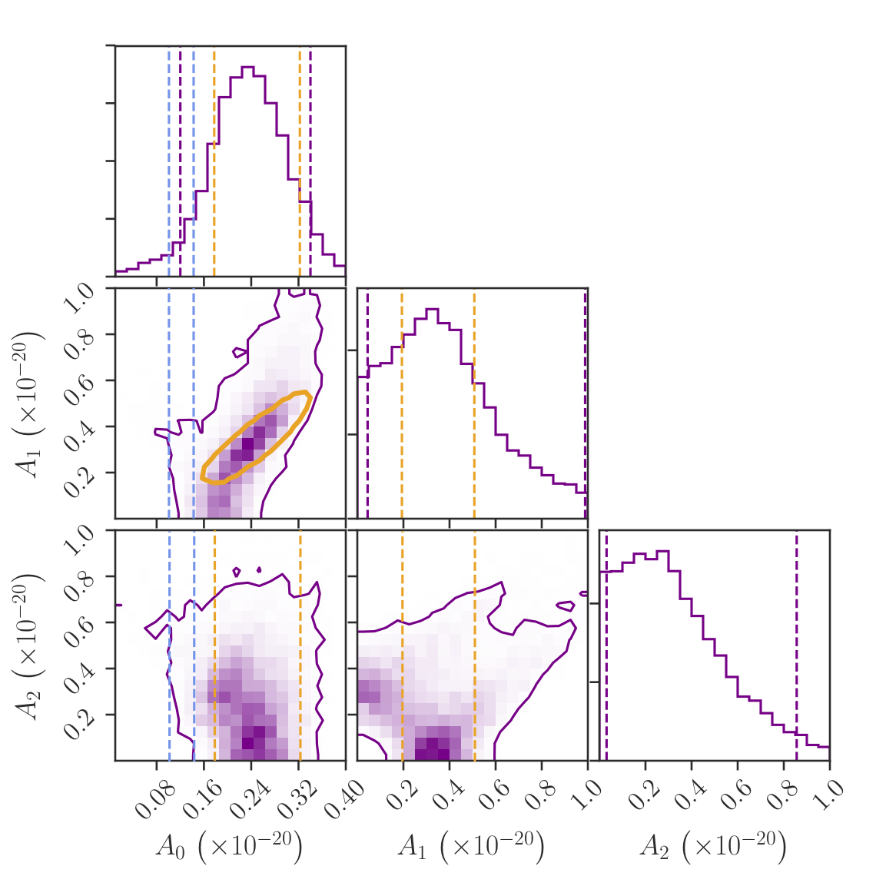
Multiple Modes in GW150914

Slide 33
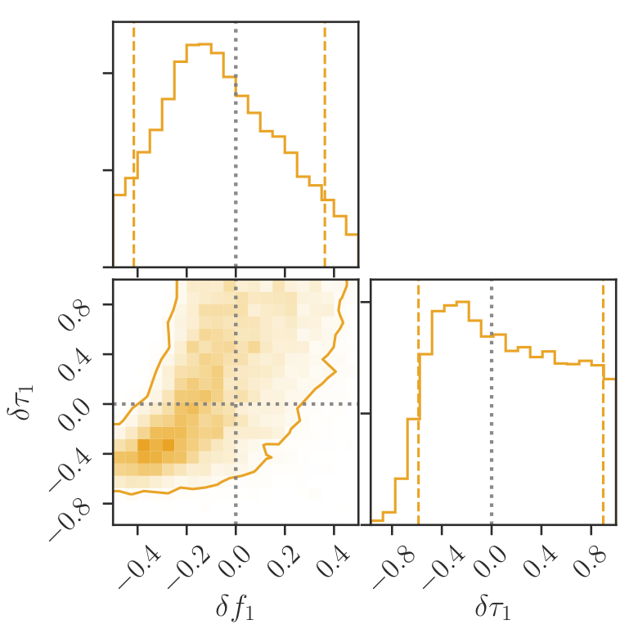
Testing GR (The No-Hair Theorem)

Slide 34
Testing GR (The No-Hair Theorem)
GR to +/- 10%

Slide 35
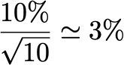
GWTC-1 has 10 BBH:

Slide 36
Isi, Chatziioannou & Farr, PRL, 123, 121101 (2019)
Chiara
Mingarelli
Katerina
Chatziioannou
Tom
Callister
Masha (Maria)
Okounkova
Jiani Ye
Maya Fishbach
Max Isi
Daniel Holz

Slide 37
Deviations from GR (e.g. in pN Series)

Slide 38
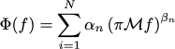
Deviations from GR (e.g. in pN Series)

Slide 39
Deviations from GR (e.g. in pN Series)

Slide 40
Deviations from GR (e.g. in pN Series)

Slide 41
Deviations from GR (e.g. in pN Series)
Abbott, et al. (2019)

Slide 42
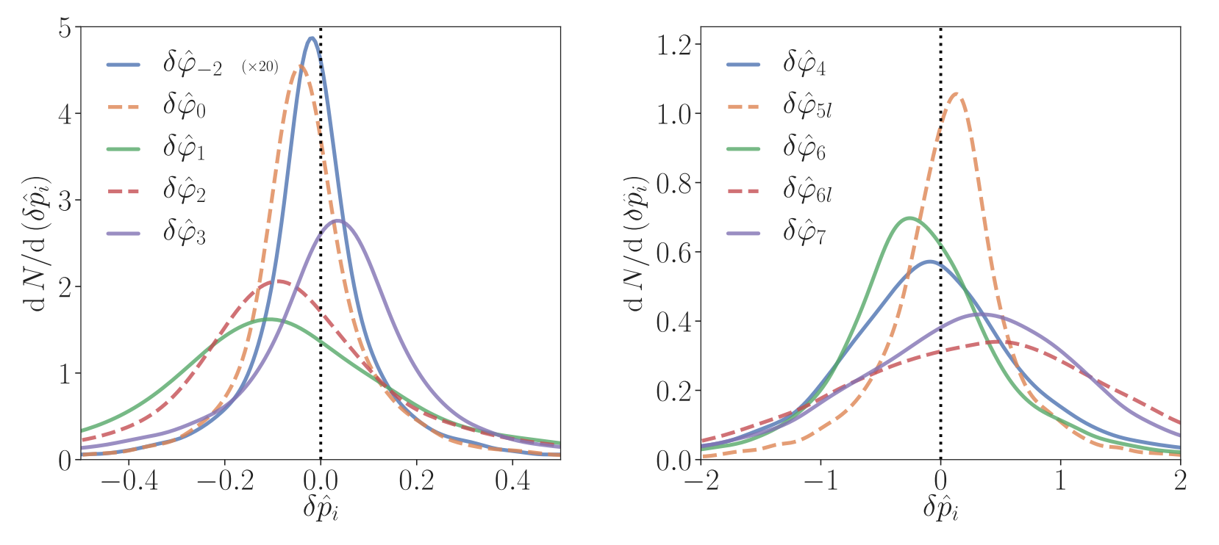
Our Method

Slide 43
Application to ringdown in progress.

Slide 44
Okounkova & Farr, in prep
Chiara
Mingarelli
Katerina
Chatziioannou
Tom
Callister
Masha (Maria)
Okounkova
Jiani Ye
Maya Fishbach
Max Isi
Daniel Holz

Slide 45
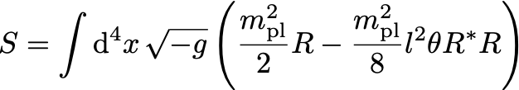
Chern-Simons Gravity
Okounkova, et al. (2019)

Slide 46
Chern-Simons Gravity
Chiral term!
Okounkova, et al. (2019)

Slide 47
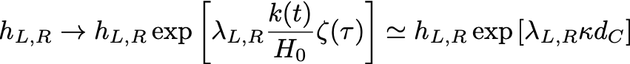
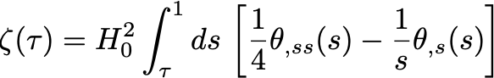
Amplitude Birefringence

Slide 48
Amplitude Birefringence
Effective opacity!

Slide 49
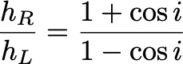
Amplitude Birefringence
Effective opacity!

Slide 50
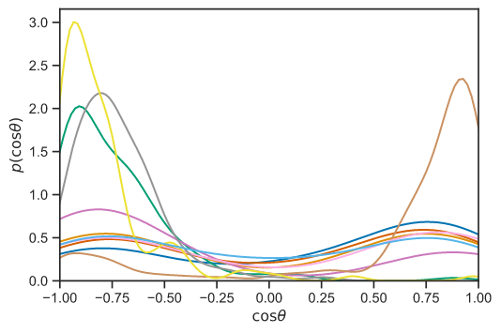
Inclinations in GWTC-1

Slide 51
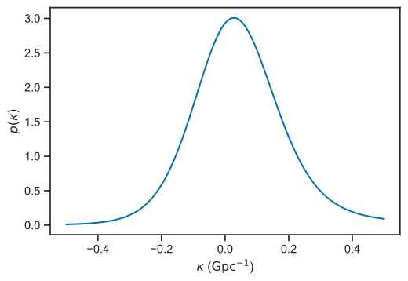
Constraints on Opacity

Slide 52
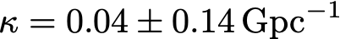
Constraints on Opacity

Slide 53
Join us (or visit)! Thanks!
Chiara
Mingarelli
Katerina
Chatziioannou
Tom
Callister
Masha (Maria)
Okounkova
Jiani Ye
Maya Fishbach
Max Isi
Daniel Holz

